Slide 1
File Organization, Record Organization
Notes:
A sector is the smallest unit of data storage on a hard drive or other storage device. It is typically 512 bytes in size, although newer drives may use larger sector sizes. A sector is the basic building block of storage on a drive. The operating system and file system use sector addresses to locate data on the disk.
A cluster, on the other hand, is a group of sectors that the file system uses as a single unit of allocation. A cluster can contain one or more sectors, and the size of a cluster depends on the file system and the size of the storage device.
The file system keeps track of which clusters are in use and which are available for allocation.
In summary, a sector is the smallest unit of data storage on a storage device, while a cluster is a group of sectors used by the file system as a single unit of allocation.

Slide 2
File Organization
The database is stored as a collection of files.
Each file is organized logically as a sequence of records.
A record is a sequence of fields.
These records are mapped into disk blocks.
File is logically partitioned into fixed-length storage units called blocks, which are the units of both storage allocation and data transfer.
Most databases use block sizes of 4 to 8 kilobytes by default
Notes:
Most databases use operating system files as an intermediate layer for storing
records, which abstract away some details of the underlying blocks. However, to ensure
efficient access, as well as to support recovery from failures (as we will see later in
Chapter 19), databases must continue to be aware of blocks. Thus, in Section 13.2, we
study how individual records are stored in files, taking block structure into account.
Given a set of records, the next decision lies in how to organize them in the file
structure; for example, they may stored in sorted order, in the order they are created,
or in an arbitrary order.
Section 13.4 then describes how databases organize data about the relational
schemas as well as storage organization, in the data dictionary. Information in the
data dictionary is crucial for many tasks, for example, to locate and retrieve records of
a relation when given the name of the relation.
A database is mapped into a number of different files that are maintained by the underlying
operating system. These files reside permanently on disks. A file is organized
logically as a sequence of records. These records are mapped onto disk blocks. Files are
provided as a basic construct in operating systems, so we shall assume the existence of
an underlying file system.We need to consider ways of representing logical data models
in terms of files.
Each file is also logically partitioned into fixed-length storage units called blocks,
which are the units of both storage allocation and data transfer. Most databases use
block sizes of 4 to 8 kilobytes by default, but many databases allow the block size to be
specified when a database instance is created. Larger block sizes can be useful in some
database applications.

Slide 3
File Organization(Cont’d)
One approach:
assume record size is fixed
each file has records of one particular type only
different files are used for different relations
An alternative is:
To structure our files so that multiple length records can be accommodated.
Notes:
In a relational database, tuples of distinct relations are generally of different
sizes. One approach to mapping the database to files is to use several files, and
to store records of only one fixed length in any given file. An alternative is to
structure our files so that we can accommodate multiple lengths for records;
however, files of fixed-length records are easier to implement than are files of
variable-length records.
we begin by considering a file of fixed-length
records, and consider storage of variable-length records later.
The content of the FAT is a series of entries that represent each cluster on the storage device. Each entry contains information about the status of the corresponding cluster, such as whether it is free or in use, as well as a pointer to the next cluster in the file. The entries are organized in a linked list, with each file having its own chain of clusters. FAT is essentially a table that keeps track of the status of each cluster (a group of sectors on the disk) on the storage device. It records which clusters are free, which are used, and which are reserved for system use.
A disk block is a fixed-size unit of storage on a disk drive. It is the smallest unit of data that can be read from or written to the disk. Disk blocks are typically 512 bytes or 4 kilobytes. Disk blocks are managed by the file system, which keeps track of which blocks are in use and which are free. This information is stored in a data structure called the file allocation table (FAT) or inodes, depending on the file system used. By organizing data into blocks, the file system can optimize disk access and improve performance.

Slide 4
Fixed-Length Records
Assume that each record of Instructor file is defined (in pseudocode) as
The instructor record is 53 bytes long
How to allocate blocks to store records ?
Simple approach
If the block size is not happens to be a multiple of 53,
then some records will cross block boundaries.
It is difficult to delete a record from this structure.
To avoid the first problem, we allocate only as many records to a block as would fit entirely in the block (this number can be computed easily by dividing the block size by the record size, and discarding the fractional part). Any remaining bytes of each block are left unused.
If block size is 120 Bytes , then store only 2 records (2*53=106) remaining 14 bytes unused.
Notes:
How to allocate blocks to store records ?
However, there are two problems with this simple approach:
1. Unless the block size happens to be a multiple of 53 (which is unlikely),
some records will cross block boundaries. That is, part of the record will
be stored in one block and part in another. It would thus require two block
accesses to read or write such a record.
2. It is difficult to delete a record from this structure. The space occupied by
the record to be deleted must be filled with some other record of the file, or
we must have a way of marking deleted records so that they can be ignored.
In a relational database, tuples of distinct relations are generally of different
sizes. One approach to mapping the database to files is to use several files, and
to store records of only one fixed length in any given file. An alternative is to
structure our files so that we can accommodate multiple lengths for records;
however, files of fixed-length records are easier to implement than are files of
variable-length records.Many of the techniques used for the former can be applied
to the variable-length case.

Slide 5
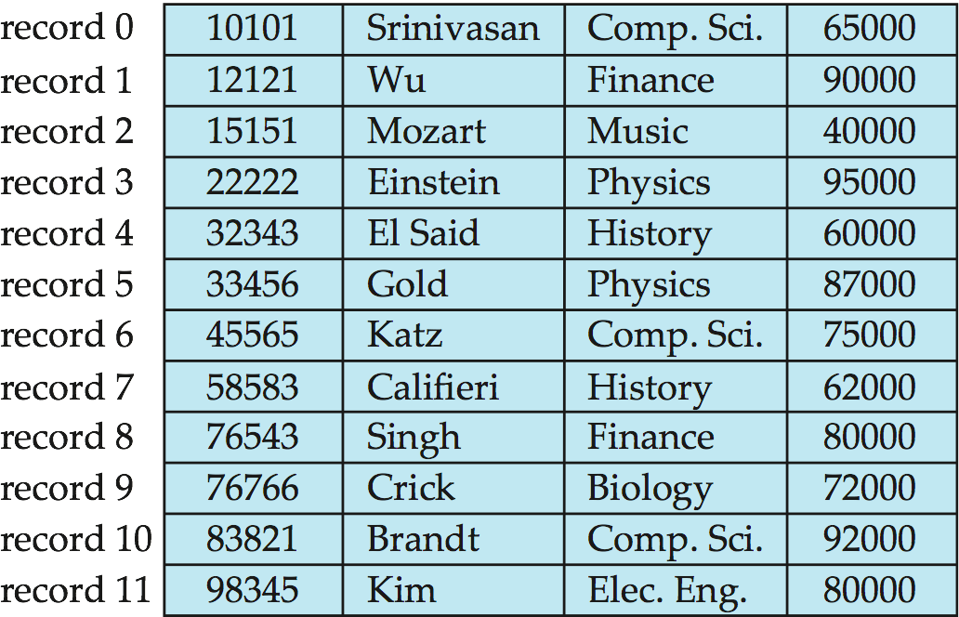
Fixed-Length Records
Simple approach:
Store record i starting from byte n ∗ (i ), where n is the size of each record. (assuming i starts with 0, n*i gives starting byte offset address)
Ex: i=0 , offset bytes for 0th record is 0 , i=1 offset bytes for 1st record is 1*53=53 byte, starting offset byte for 2nd record is 2*53=106th byte.
Record access is simple but records may cross blocks
Modification: do not allow records to cross block boundaries
Deletion of record i: alternatives:
move records i + 1, . . ., n to i, . . . , n – 1
move record n^{th} to i^{th}
do not move records, but link all free records on a free list

Slide 6
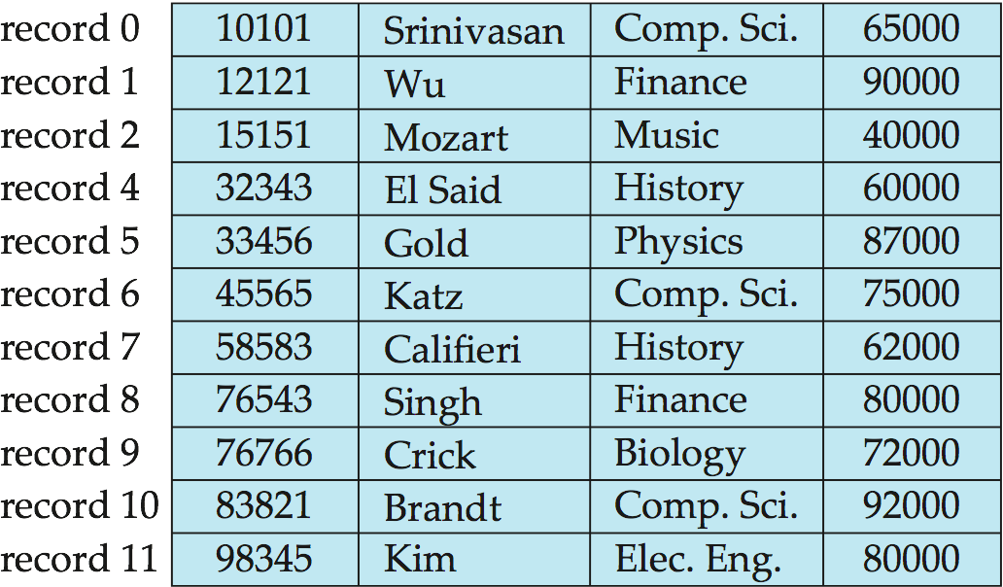
Deleting record 3 and compacting
move records i + 1, . . ., n to i, . . . , n – 1

Slide 7
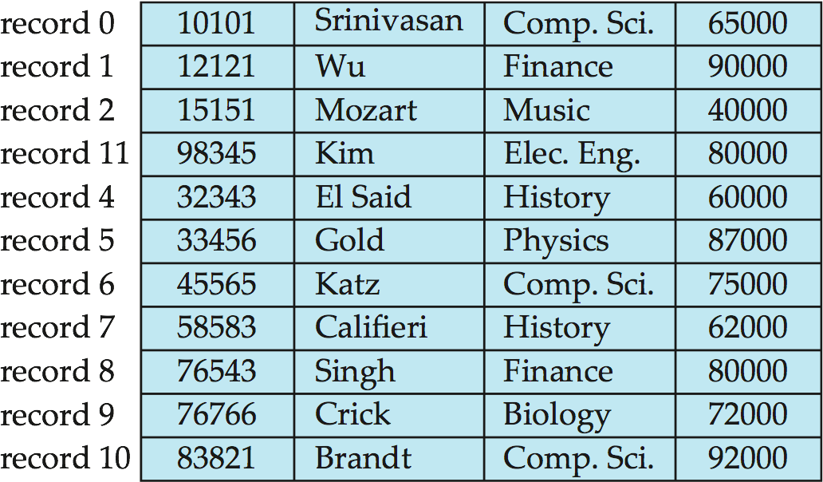
2. Deleting record 3 and moving last record
move record n to i

Slide 8
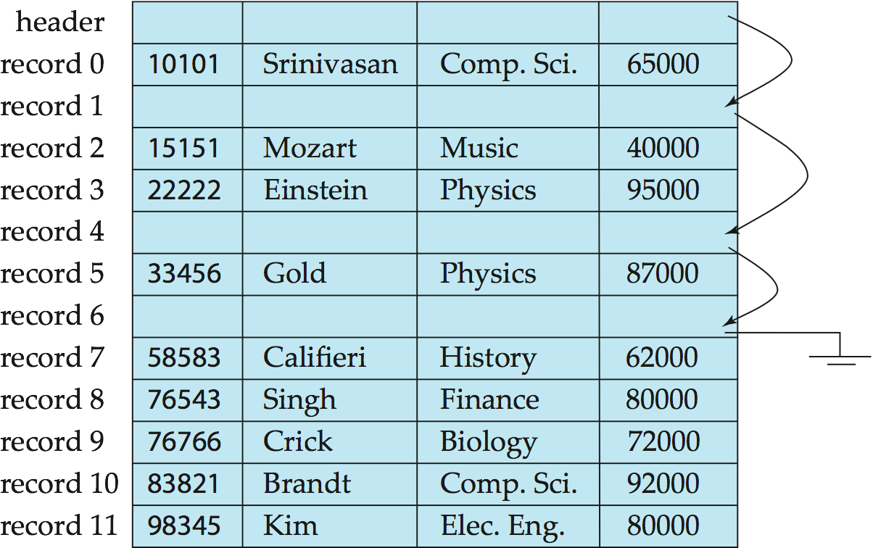
3. Free Lists
Store the address of the first deleted record in the file header.
Use this first record to store the address of the second deleted record, and so on
The deleted records thus form a linked list, which is often referred to as a free list
On insertion of a new record, we use the record pointed to by the header and change the header pointer to point to the next available record. of the file.
If no space (free list empty) then
add the new record to the end.
Notes:
More space efficient representation: reuse space for normal attributes of free records to store pointers. (No pointers stored in in-use records.)

Slide 9
Variable-Length Records
Why Variable-length records ?
Storage of multiple record types in a file.
Record types that allow variable lengths for one or more fields such as strings (varchar)
Record types that allow repeating fields (arrays or multisets)
Problems needs to be addressed:
How to represent attributes in a single record in such a way that individual attributes can be extracted easily
How to store variable-length records within a block, such that records in a block can be extracted easily

Slide 10
Representation of records with variable length attributes
Addressing-How individual attributes are extracted
Attributes are stored in order.
Representation of records consists of two parts: an initial part with fixed length attributes, followed by data for variable-length attributes.
Fixed-length attributes are allocated as many bytes as required to store their value.
In the initial part of record, Variable-length attributes are represented by a pair(offset, length), where offset denotes where the data for that attribute begins within the record, and the length is the length in bytes of the variable sized attribute.
Null values represented by null-value bitmap, which indicates which attributes of the record have a null value.

Slide 11
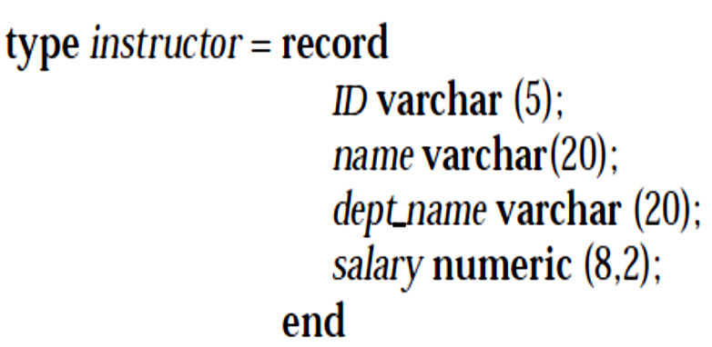
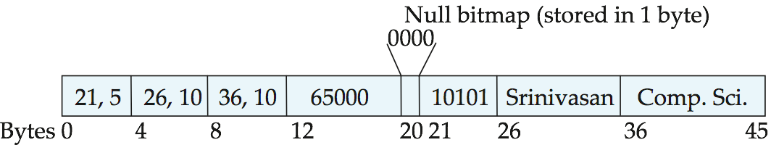
Variable-Length Records
Offset , length
salary
ID
name
dept_name
The figure shows an instructor record, whose first three attributes ID, name, and dept_name are variable-length strings, and whose fourth attribute salary is a fixed-sized number.
A null bitmap, which indicates which attributes of the record have a null value. Above example 4 bits are used because there are 4 attributes.
In this particular record, if the salary were null, the 1st bit of the bitmap would be set to 1 i.e. 1000(while reading 12th to 19th bytes ignored)
Notes:
An example of such a record representation is shown in Figure 10.8. The figure
shows an instructor record, whose first three attributes ID, name, and dept name are
variable-length strings, and whose fourth attribute salary is a fixed-sized number.
We assume that the offset and length values are stored in two bytes each, for a
total of 4 bytes per attribute. The salary attribute is assumed to be stored in 8 bytes,
and each string takes as many bytes as it has characters.
The figure also illustrates the use of a null bitmap, which indicates which
attributes of the record have a null value. In this particular record, if the salary
were null, the fourth bit of the bitmap would be set to 1, and the salary value stored
in bytes 12 through 19 would be ignored.

Slide 12
Variable-Length Records organizing records within a block
Next problem to be addressed is about- storing variable-length records in a Block
The slotted-page structure is commonly used for organizing records within a block

Slide 13
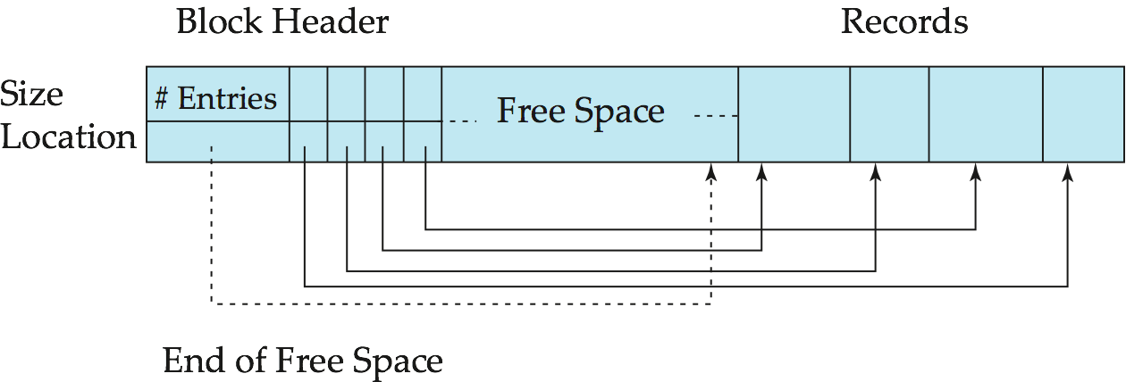
Storing Variable-Length Records: Slotted Page Structure
Addressing-How to store variable-length records within a block.
1
3-size
2
3
Header(Slotted page header) in the beginning of each block contains:
number of record entries.
end of free space in the block.
location and size of each record.
The actual records are allocated contiguously in the block, starting from the end of the block. The free space in the block is contiguous, between the final entry in the header array, and the first record.
Records can be moved around within a page to keep them contiguous with no empty space between them; entry in the header must be updated.
Notes:
2
The actual records are allocated contiguously in the block, starting from the
end of the block. The free space in the block is contiguous, between the final entry
in the header array, and the first record. If a record is inserted, space is allocated
for it at the end of free space, and an entry containing its size and location is
added to the header.
If a record is deleted, the space that it occupies is freed, and its entry is set to
deleted (its size is set to −1, for example). Further, the records in the block before
the deleted record are moved, so that the free space created by the deletion gets
occupied, and all free space is again between the final entry in the header array
and the first record. The end-of-free-space pointer in the header is appropriately
updated as well. Records can be grown or shrunk by similar techniques, as long
as there is space in the block. The cost of moving the records is not too high, since
the size of a block is limited: typical values are around 4 to 8 kilobytes.

Slide 14
Variable-Length Records: Slotted Page Structure
How to do Insert & Delete ?
If a record is inserted, space is allocated for it at the end of free space, and an entry containing its size and location is added to the header. Number of record entry incremented .
A record is deleted, the space that it occupies is freed, and its entry is set to deleted.
Further, the records in the block before the deleted record are moved, so that the free space created by the deletion gets occupied, and all free space is again between the final entry in the header array and the first record.
The end-of-free-space pointer in the header is appropriately updated as well.
Records can be grown or shrunk by similar techniques, as long as there is space in the block.
Notes:
Most relational databases restrict the size of a record to be no larger than
the size of a block, to simplify buffer management and free-space management.
Large objects are often stored in a special file (or collection of files) instead of
being stored with the other (short) attributes of records in which they occur. A
(logical) pointer to the object is then stored in the record containing the large
object. Large objects are often represented using B+-tree file organizations

Slide 15
Organization of Records in Files
Heap – a record can be placed anywhere in the file where there is space.
Sequential – store records in sequential order, based on the value of the search key of each record.
Hashing – a hash function computed on some attribute of each record; the result specifies in which block of the file the record should be placed
Records of each relation may be stored in a separate file.
In a multitable clustering file organization records of several different relations can be stored in the same file
Motivation: store related records on the same block to minimize I/O

Slide 16
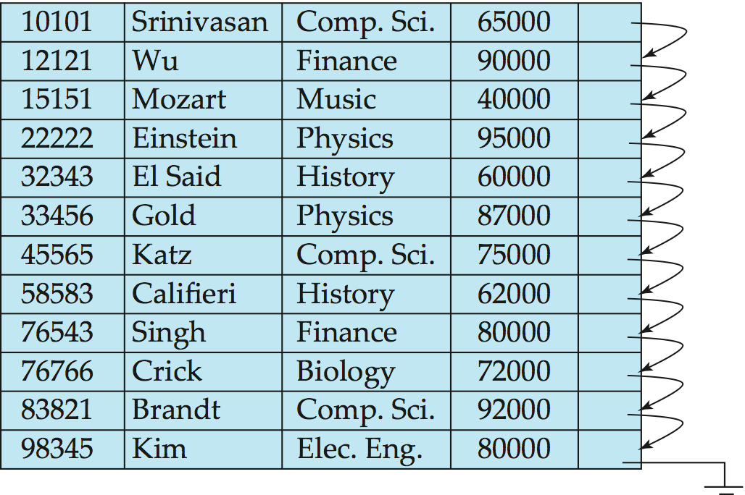
Sequential File Organization
Suitable for applications that require sequential processing of the entire file.
The records in the file are ordered by a search-key
Notes:
To permit fast retrieval of records
in search-key order, we chain together records by pointers. The pointer in each
record points to the next record in search-key order. Furthermore, to minimize the
number of block accesses in sequential file processing, we store records physically
in search-key order, or as close to search-key order as possible.

Slide 17
Sequential File Organization (Cont.)
Deletion – use pointer chains (Free List).
Insertion –locate the position where the record is to be inserted
if there is free space insert there.
if no free space, insert the record in an overflow block
In either case, pointer chain must be updated.
Need to reorganize the file from time to time to restore sequential order.
Notes:
For insertion, we apply the following rules:
1. Locate the record in the file that comes before the record to be inserted in
search-key order.
2. If there is a free record (that is, space left after a deletion) within the same
block as this record, insert the new record there. Otherwise, insert the new
record in an overflow block. In either case, adjust the pointers so as to chain
together the records in search-key order.

Slide 18
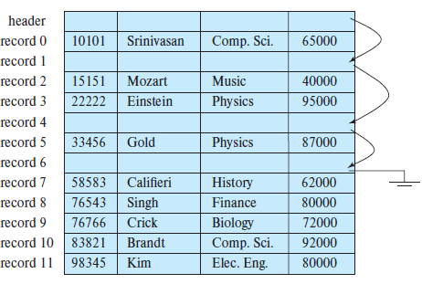
Free List
File, with free list after deletion of records 1, 4, and 6.

Slide 19
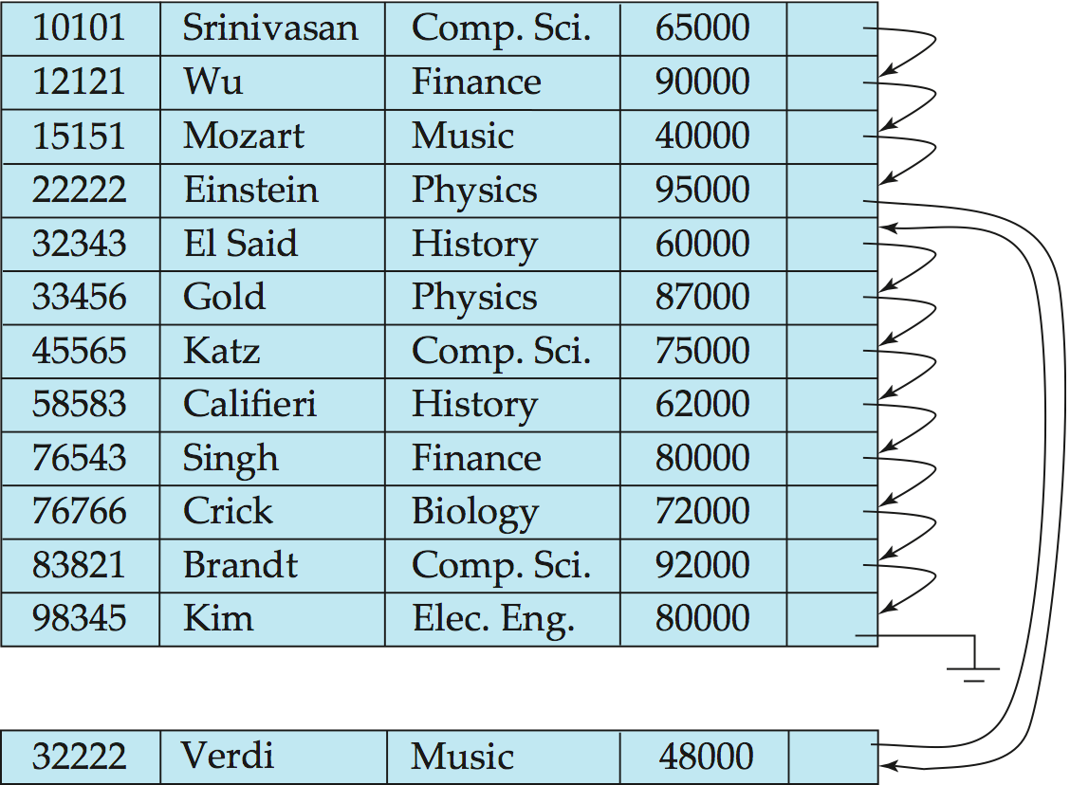
Sequential File Organization (Cont.)
no free space, insert the record in an overflow block

Slide 20
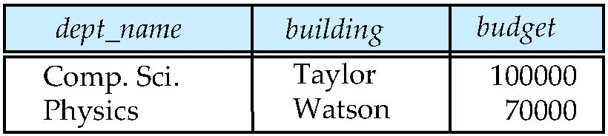
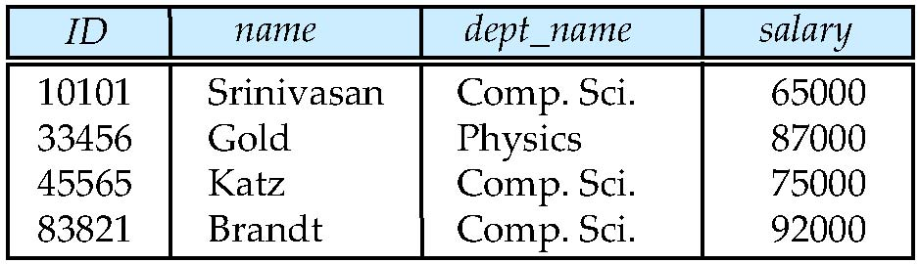
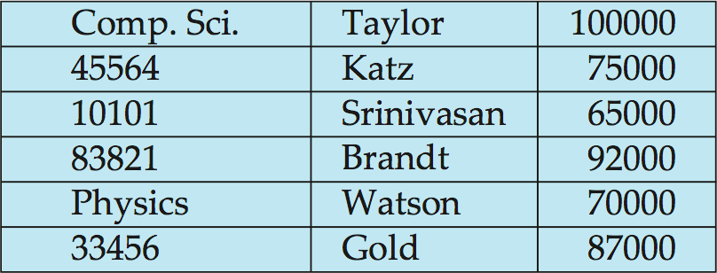
Multitable Clustering File Organization
Store several relations in one file using a multitable clustering file organization
department
instructor
Multi-table clustering
of department and
instructor
The cluster key is the attribute that defines which records are stored together; Here – Dept_name
Notes:
Stores related records of two or more relations in each block
Multitable clustering is supported by the Oracle database system. Clusters can be
created by using a create cluster command, with a specified cluster key. An extension
of the create table command can be used to specify that a relation is to be stored in
a specific cluster, with a particular attribute used as the cluster key. Multiple relations
can thus be allocated to a cluster.
To get cluster information.
SELECT * FROM USER_CLU_COLUMNS

Slide 21
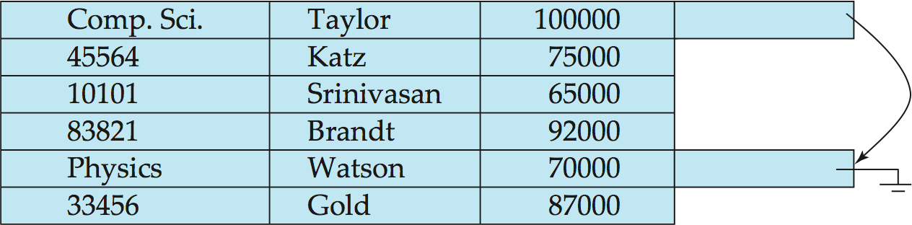
Multitable Clustering File Organization (cont.)
good for queries involving department instructor, and for queries involving one single department and its instructors
bad for queries involving only department
results in variable size records
Can add pointer chains to link records of a particular relation

Slide 22
Data Dictionary Storage
The Data dictionary (also called system catalog) stores metadata; that is, data about data, such as
Information about relations
names of relations
names, types and lengths of attributes of each relation
names and definitions of views
integrity constraints
User and accounting information, including passwords
Statistical and descriptive data
number of tuples in each relation
Physical file organization information
How relation is stored (sequential/hash/…)
Physical location of relation

Slide 23
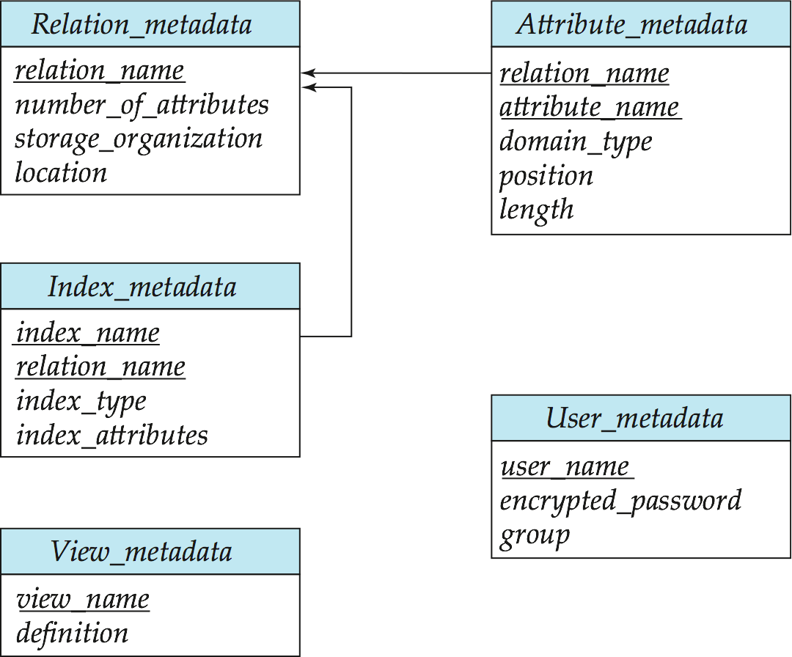
Relational Representation of System Metadata
All this metadata information constitutes, in effect, a miniature database.
Relational representation on disk
Specialized data structures designed for efficient access, in memory
Notes:
CREATE INDEX index_name ON table_name(column1[,column2,...])
CREATE INDEX members_last_name_i ON members(last_name);
SELECT index_name, index_type, visibility, status FROM all_indexes WHERE table_name = 'MEMBERS’;
SELECT * FROM members WHERE last_name = 'Harse’;
This explains the execution plan into the plan_table table.
EXPLAIN PLAN FOR SELECT * FROM members WHERE last_name = 'Harse’;
Then, use the DBMS_XPLAN.DISPLAY() procedure to show the content of the plan_table:
SELECT PLAN_TABLE_OUTPUT FROM TABLE(DBMS_XPLAN.DISPLAY());

Slide 24
END
In the next Chapter we will discuss other file organization-
Indexing

